Slide 1
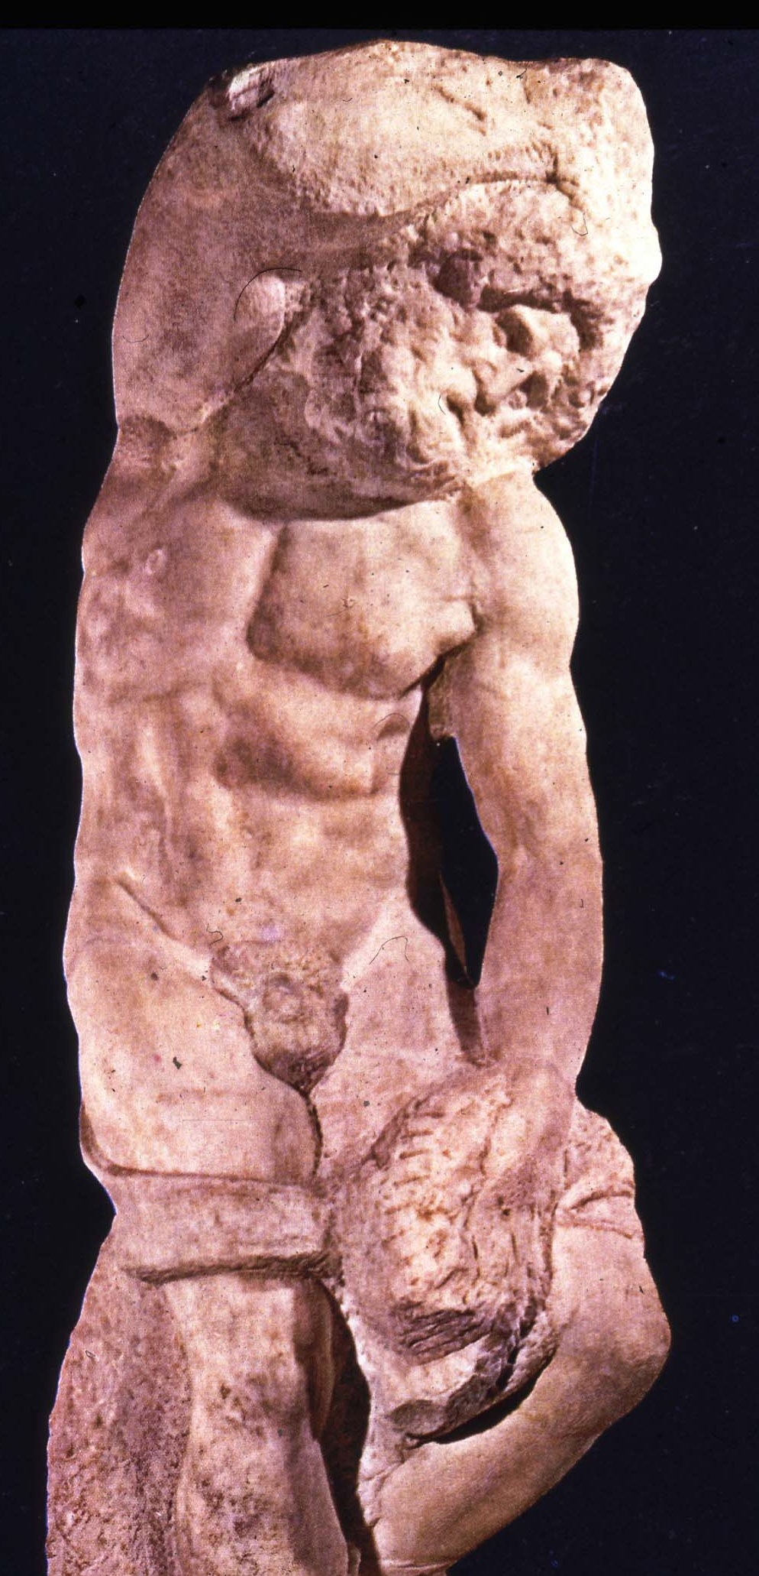

Current approaches to the symptomatic relief of FOP
Robert J. Pignolo, M.D., Ph.D.
Ian Cali Clinical & Research Scholar
Center for Research in FOP & Related Disorders
University of Pennsylvania School Of Medicine
Philadelphia, PA USA

Slide 2
Current approaches to the symptomatic relief of FOP
We emphasize that this report reflects the authors’ experience and opinions on the various classes of symptom-modifying medications, and is meant only as a guide to this controversial area of therapeutics. Although there are common physical features shared by every person who has FOP, there are differences among individuals that may alter the potential benefits or risks of any medication or class of medications discussed here. The decision to use or withhold a particular medication must ultimately rest with an individual patient and his or her physician.
The International Clinical Consortium on FOP. Clin Proc Intl Clin Consort FOP 4:1-99, 2011

Slide 3
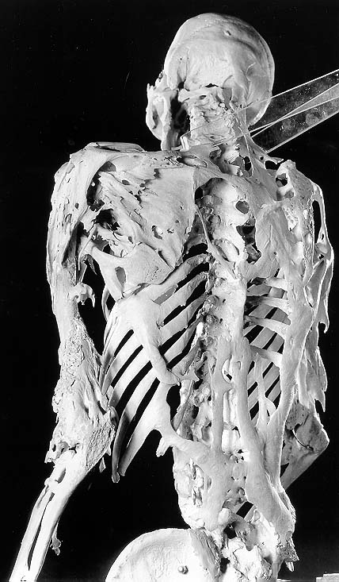
Current approaches to the symptomatic relief of FOP
Medications
Pain Management
Injury Prevention
Special Situations
& Complications

Slide 4
Current approaches to the symptomatic relief of FOP
Medications
Pain Management
Injury Prevention
Special Situations
& Complications

Slide 5
Medications
Class I: Medications that have been widely used to control symptoms of the acute flare-up (swelling and pain), with anecdotal reports of favorable results and minimal side effects
Examples: Short-term use of high-dose corticosteroids, and use of non-steroidal anti-inflammatory drugs (NSAIDs) including anti-inflammatory and anti-angiogenic cox-2 inhibitors.

Slide 6
Medications
Class II: Medications that have theoretical application to FOP, are approved for the treatment of other disorders, and have limited and well-described effects.
Examples: Leukotriene inhibitors, mast cell stabilizers, and aminobisphosphonates (Pamidronate; Zoledronate).

Slide 7
Medications
Class III: Investigational new drugs
Examples: Signal transduction inhibitors, monoclonal antibodies targeting ACVR1, and retinoic acid receptor gamma agonists (presently under development).

Slide 8
Corticosteroids
Brief 4-day course of high-dose corticosteroids, begun within the first 24 hours of a flare-up, may help reduce the early intense inflammation and tissue edema
The use of corticosteroids should be restricted to:
The extremely early symptomatic treatment of flare-ups that affect:
Major joints
Jaw
Submandibular area
Prevention of flare-ups following major soft tissue injury (severe trauma)
Prevention of flare-ups in emergent, elective, and minor surgeries such as dental surgery, hypospadias repair, appendectomies, etc. (peri-operative use

Slide 9
Corticosteroids
Corticosteroids should not generally be used for:
Flare-ups involving the neck or trunk
long duration and recurring nature
difficulty in assessing the true onset
tend to recur rapidly following cessation of corticosteroid therapy
On rare occasions, a brief course of corticosteroids may be used to break the cycle of recurrent flare-ups often seen in early childhood

Slide 10
Corticosteroids
Dose is dependent upon body weight
Dose of prednisone is 2 mg/kg/day (up to 100 mg)
Administered as a single daily dose for 4 days
Should be given in the morning to have the least suppressive effect on the hypothalamic-pituitary-adrenal axis

Slide 11
Corticosteroids
Alternatively:
High dose intravenous corticosteroid pulse therapy may be considered
Must be performed with an inpatient hospitalization to monitor for potentially dangerous side-effects of hypertension

Slide 12
Corticosteroids
When prednisone is discontinued, a non-steroidal anti-inflammatory medication or cox-2 inhibitor (in conjunction with a leukotriene inhibitor) may be used symptomatically for the duration of the flare-up
Corticosteroids should not be used for the long-term chronic treatment of FOP
chronic dependence due to adrenal suppression
other steroid-associated side-effects

Slide 13
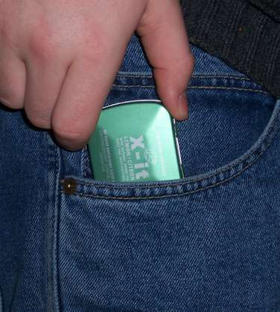
“Pill in the pocket” approach
While patients are encouraged to contact their physician at the earliest sign of a flare-up, many find it comforting to have a supply of prednisone on hand at home in case of an emergency
This “pill in the pocket” approach has been feasible and safe with a monitored reduction in emergency room and hospital visits

Slide 14
Cyclo-oxygenase 2 Inhibitors & NSAIDs
Response to tissue
injury and repair
Cox-2 inhibitors
NSAIDS
Physiological PGs
Inflammatory PGs
ASA
Ibuprofen
indomethacin
Protection of tissues
(e.g., stomach)

Slide 15
Cyclo-oxygenase 2 Inhibitors & NSAIDs
Animals pretreated with inhibitors of prostaglandin synthesis fail to form heterotopic bone following intramuscular injections of BMP-containing demineralized bone matrix (DiCesare et al., 1991)
Animals treated with prostagland inhibitors co-incident with or following an injection of demineralized bone matrix still form heterotopic bone.
In order for inhibitors of prostaglandin synthesis to be truly effective in preventing heterotopic ossification, the medication must be circulating in the blood at therapeutic levels before a bone-induction signal occurs
NSAIDs, and cox-2 inhibitors have potent anti-angiogenic properties especially at high dosages

Slide 16
Cyclo-oxygenase 2 Inhibitors & NSAIDs
Inflammatory prostaglandin levels are dramatically elevated in the urine of patients who have FOP, especially during a disease flare-up
Compared to NSAIDs, the selective cox-2 inhibitors offer the possibility of a lower gastrointestinal risk profile
Concerns have been raised about the safety of the cox-2 inhibitors, including rofecoxib (Vioxx), celecoxib (Celebrex), and valdecoxib (Bextra) in patients at high risk of cardiovascular and cerebrovascular disease
Although the cox-2 enzyme is necessary for the synthesis of inflammatory prostaglandins, it also controls synthesis of prostacyclin, a prostaglandin that is essential for the integrity of blood vessels, especially in the heart and brain
Levitz et al., 1992; White et al., 2002; White et al., 2003; Couzin, 2004; Grosser et al., 2006

Slide 17
Aminobisphosphonates
Beneficial anecdotal effects of high-dose aminobisphosphonates in preventing recurrence of heterotopic ossification in high-risk patients with established heterotopic ossification who were undergoing surgery to excise heterotopic bone
One of the five patients reported had FOP
Schuetz et al., 2005

Slide 18
Aminobisphosphonates
> 12 FOP patients have used Pamidronate (either alone or with steroids) for the treatment of acute flare-ups
10 of the 13 patients (77%) had reported improvement in symptoms and signs of an FOP flare-up
3 of the 13 patients (23%) reported improvement in the symptoms or signs
No protective effect on the occurrence of subsequent flare-ups
Improvement was transient and affected only the lesion present at the time of the flare-up

Slide 19
Aminobisphosphonates
Excellent safety and efficacy profile in protecting the normotopic skeleton from the osteopenic effects of intermittent high-dose glucocorticoids in the type of regimen that is frequently used to manage acute flare-ups of FOP (Nogginuera et al., 2003; Sambrook et al., 2003; Staa & Cooper, 2003).

Slide 20
Mast Cell Inhibitors
Mobilization and activation of inflammatory mast cells is found at all stages of FOP lesional development
Mast cell stabilizers, long-acting non-sedating antihistamines, leukotriene inhibitors, non-steroidal anti-inflammatory medications, and cox-2 inhibitors may help reduce mast cells, macrophages, lymphocytes, and their associated inflammatory-mediators
Mast cell membrane stabilizers may reduce the release of angiogenic and chemotactic factors, while anti-histamines and leukotriene inhibitors may reduce the downstream effects of released mediators (Simmons, 2004).
The optimal use of these medications and their potential efficacy in FOP is presently unknown.

Slide 21
Mast Cell Inhibitors
Can be added at the physicians’ discretion
The leukotriene inhibitor montelukast (Singulair) can be considered at a dose of 5 mg or 10 mg per oral daily (depending upon age) in order to help abrogate the inflammatory symptoms of an FOP flare-up
The combined use of montelukast and a non-steroidal anti-inflammatory agent or a cox-2 inhibitor can be considered as a long-term treatment, following the discontinuation of a single 4-day steroid burst
Sodium cromolyn is a generally well-tolerated mast cell inhibitor
oral absorption is poor, and its potential effectiveness in FOP is unknown

Slide 22
Chemotherapy Agents & Radiation Therapy
No convincing anecdotal evidence that either radiation therapy or any of the standard chemotherapy agents such as actinomycin, vincristine, vinblastine, cyclosphosphamide, doxorubicin, ifosfamide, adriamycin, or any others were helpful for patients with FOP
Many of these medications caused harmful long-term side-effects
Contraindicated in the treatment of FOP (Glaser & Kaplan, 2005; Kaplan et al., 2008)
One case report that documents apparently successful treatment of FOP with surgical excision of heterotopic bone, indomethacin, and irradiation. Follow-up was brief (Benetos et al., 2006)
At the present time, this approach cannot be endorsed

Slide 23
Current approaches to the symptomatic relief of FOP
Medications
Pain Management
Injury Prevention
Special Situations
& Complications

Slide 24
Acute & Chronic Pain Management in FOP
Many FOP flare-ups, especially those around the hips and knees, are extremely painful
Brief course of well-monitored narcotic analgesia
Non-steroidal anti-inflammatory medications, cox-2 inhibitors, and/or oral or IV glucocorticoids
Other types of transient pain syndromes:
Neuropathies
Transient bursitis
Inflammation of osteochondromas
Arthritis
Muscle fatigue
Generalized chronic pain syndrome (advanced FOP)
specialized pain management programs

Slide 25
Muscle Relaxants
Early flare-ups are associated with intense mast cell, macrophage, and lymphocytic infiltration into skeletal muscle and often accompanied by intense inflammatory changes within damaged or necrotic skeletal muscle
Areas of relatively healthy skeletal muscle bordering the lesion are subject to metabolic changes that would lead to muscle spasm and fiber shortening
short-term use of muscle relaxants such as cyclobenzaprine (Flexeril), metaxalone (Skelaxin), or liorisal (Baclofen) may help to decrease muscle spasm
especially for painful flare-ups involving the muscle groups of the back and limbs

Slide 26
Current approaches to the symptomatic relief of FOP
Medications
Pain Management
Injury Prevention
Special Situations
& Complications

Slide 27
Injury Prevention in FOP
Safe | Unsafe
Subcutaneous injections | Intramuscular injections
Routine measles-mumps-rubella immunizations administered by subcutaneous injection | Routine childhood diphtheria-tetanus-pertussis immunizations administered by intramuscular injection
Routine venipuncture | Arterial punctures
Precautiously administered dental care | Overstretching of the jaw; Intramuscular injections of local anesthetic (i.e., mandibular blocks)
 | Biopsies of FOP lesions

Slide 28
Prevention of falls
Modification of activity
Improvement in household safety, use of ambulatory devices (such as a cane, if possible), and use of protective headgear
Redirection of activity to less physically interactive play
Supportive hand-railings on stairs, securing loose carpeting, removing objects from walkways, and eliminating uneven flooring including doorframe thresholds
Complete avoidance of high-risk circumstances may reduce falls, but also may compromise a patient’s functional level and independence, and may be unacceptable to many

Slide 29
Immunizations & FOP - Influenza
Indications | Contraindications
Subcutaneously | Allergy to eggs
Smallest possible needle | Previous severe adverse reaction
Ice, intermittently x 24 hr | Active flare-up
Antiviral medication | Nasal administration/ live attenuated virus
Vaccination of household contacts

Slide 30
Other Immunizations
Several vaccines can be given via the subcutaneous (SC) route and will still be effective:
Measles, mumps, rubella (MMR)
Meningococcal polysaccharide (MPSV)
Pneumococcal polysaccharide (PPV)
Polio vaccine, inactivated (IPV)
Varicella
Measles, mumps, rubella, varicella (MMRV)
Some vaccines can be given only by the IM route. Administration by the SC or intradermal route may cause increased local irritation, induration, skin discoloration, inflammation and granuloma formation. They are:
Diphtheria, tetanus, pertussis (DTaP, DT, Tdap, Td)
Haemophilus influenzae type b (Hib)
Hepatitis A (HepA)
Hepatitis B (HepB)
Human papilloma virus (HPV)
Pneumococcal conjugate (PCV)
For most individuals with FOP, the infant series of immunizations will have been completed before the diagnosis of FOP has been made
See http://www.cdc.gov/mmwr/preview/mmwrhtml/rr6002a1.htm?s_cid=rr6002a1_e for complete list of vaccines and routes of administration

Slide 31
Preventive Oral Healthcare in FOP
Individuals with FOP have developmental anomalies of the temporomandibular joints (TMJs) (Connor & Evans, 1982; Renton et al., 1982; Carvalho et al., 2011)
Spontaneous or post-traumatic ankylosis of the TMJs is common and leads to severe disability with resultant difficulties in eating and poor oral hygiene
Great care must be taken not to provoke flare-ups of the TMJ (Luchetti et al., 1996)

Slide 32
Preventive Oral Healthcare in FOP
Preventive oral and dental health care measures are essential in during childhood years (Young et al., 2007)
Ultrasonic tooth brushes with small heads and water piks may also help with dental hygiene
Fluoridation of water
High dose fluoride toothpaste, fluoride gels and rinses
Chlorhexidine rinses are to prevent gingivitis and tooth decay
Frequent flossing and brushing are necessary but may be difficult due to limited jaw opening

Slide 33
Preventive Oral Healthcare in FOP
FOP patients who still have mouth opening can be treated with normal dental instruments as in unaffected individuals, but prevent overstretching of the TMJs
In patients who have ankylosed TMJs, professional instrumentation and special toothbrushes may be helpful, but are often limited to use on the buccal surfaces
Antimicrobial and fluoride rinses may be the only method to reach the lingual and palatal surfaces (Nussbaum et al., 2005)
Patients with a high risk of dental caries or difficulty in maintaining good oral hygiene may request that their dentist professionally apply fluoride varnish or a bioerodible and fluoride resin

Slide 34
Dental Anesthesia in FOP
FOP patients have limited options for dental anesthesia
Mandibular blocks are forbidden as they will lead to ossification of the pterygoid muscles and rapid ankylosis of the TMJ (Luchetti et al., 1996)
Infiltration anesthesia is difficult in the mandibular posterior molar areas of permanent teeth
Successful anesthesia in mandibular primary teeth can be achieved by infiltration through the dental pulp
Interligamentary infiltration may be helpful in anterior maxilary extractions, if performed carefully
General anesthesia may be needed for dental care in FOP patients (Nussbaum et al., 1996; Nussbaum et al., 2005).

Slide 35
General Anesthesia in FOP
Preparation for a surgical procedure in an FOP patient should follow the same guidelines and recommendations as for all un-affected individuals
Procedures should be performed only at facilities equipped with the skills and support systems necessary for a safe outcome
For patients with advanced disease, it is recommended that even minor procedures (colonoscopies, dental procedures) be performed at a major medical center under general anesthesia with a secured airway by endotracheal intubation

Slide 36
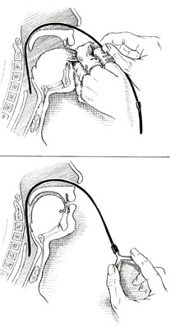
General Anesthesia in FOP
Patients who can open the mouth: It is imperative to avoid over-stretching the TMJ during direct laryngoscopy. Careful positioning of the patient and the head, maintenance of a sniffing position and the use of laryngoscopes with minimal mouth opening is one approach of securing the airway
Patients who cannot open the mouth. In patients who present with fusion of the cervical vertebrae, limited mouth opening, or ankylosis of the TMJ, oral access for endotracheal intubation is not possible. For these patients, an awake fiberoptic naso-tracheal intubation under light sedation is recommended

Slide 37
Current approaches to the symptomatic relief of FOP
Medications
Pain Management
Injury Prevention
Special Situations
& Complications

Slide 38
Cardiopulmonary Function in FOP
Patients with FOP develop thoracic insufficiency syndrome (TIS) that can lead to life-threatening complications
Pneumonia and right-sided heart failure are the major life-threatening hazards that result from TIS
Prophylactic measures:
Maximize pulmonary function
Minimize respiratory compromise
Prevent influenza and pneumonia
May be helpful in decreasing the morbidity and mortality from TIS in patients with FOP (Kussmaul et al., 1998; Kaplan & Glaser, 2005; Kaplan et al., 2010).

Slide 39
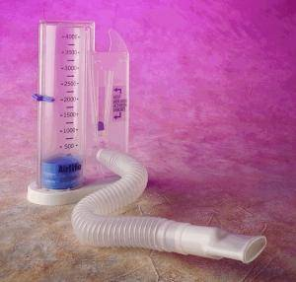
Cardiopulmonary Function in FOP
Inspiratory and expiratory muscle training should be routinely practiced
Incentive spirometers to encourage deep breathing
Prevention and therapy of intercurrent chest infections
Prophylactic pneumococcal pneumonia and influenza vaccinations (given subcutaneously)
Chest physiotherapy
Prompt antibiotic treatment of early chest infection
Avoidance of upper abdominal surgery
Sleep studies to assess sleep apnea
Positive pressure assisted breathing devices such as BiPAP® (Bi-level positive airway pressure) masks without the use of supplemental oxygen
Patients with FOP who have advanced TIS who use unmonitored oxygen have a high risk of sudden death
Sudden correction of oxygen tension in the presence of chronic carbon dioxide retention suppresses respiratory drive (Kaplan & Glaser, 2005).

Slide 40
Cardiopulmonary Function in FOP
Evaluation by a pulmonologist by the end of the first decade of life
Baseline pulmonary function tests
Baseline echocardiograms
Results of these tests may further help guide preventative care for the cardiopulmonary system

Slide 41

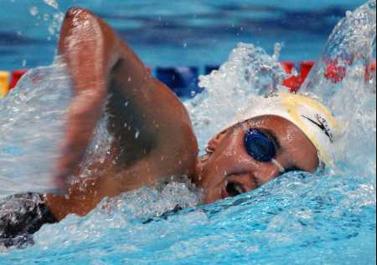

Cardiopulmonary Function in FOP
Activities to promote pulmonary function:
deep breathing
swimming/hydrotherapy
singing

Slide 42
Submandibular flare-up
Medical emergency
Early identification
Avoidance of lesional manipulation
Airway monitoring
Aspiration precautions
Nutritional support
Corticosteroids
Longer use with an appropriate taper for the duration of the flare-up or until the acute swelling subsides
Following discontinuation of the glucocorticoid, non-steroidal anti-inflammatory medications or a cox-2 inhibitor can be considered for the next 6-8 weeks.

Slide 43
Submandibular flare-up
Dental professionals often misdiagnose FOP patients with submandibular flare-ups as having dental abscesses or odontogenic infection
Any manipulation of the soft tissues of the mouth, or the head, or neck will hasten inflammation and worsen the clinical problems of heterotopic bone formation

Slide 44
Submandibular flare-up
Patients should sleep with their head elevated if possible to decrease the risk of airway obstruction
They should be hospitalized immediately in the event of pending obstruction of the airway
Food should be pureed or semi-solid
Clear liquids often provoke choking episodes
Patients should be encouraged to eat frequently to minimize weight loss
Additional high calorie food supplements should also be considered
Assiduous precautions should be undertaken to prevent food aspiration

Slide 45
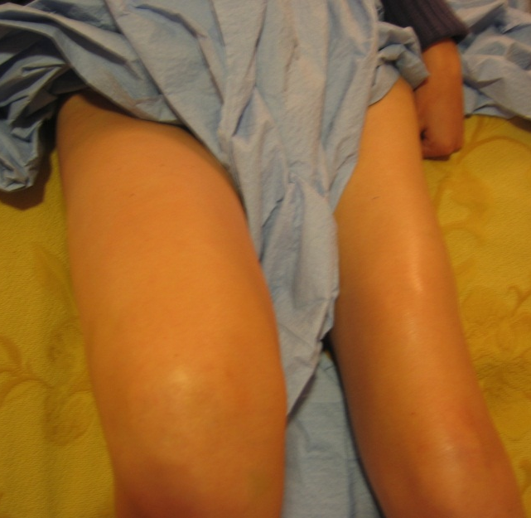
Limb Swelling in FOP
Acute and often severe limb swelling seen with flare-ups of FOP
Due to intense inflammation, angiogenesis and capillary leakage
May grow to extraordinary and alarming size
May lead to extravascular compression of nerves and tissue lymphatics
Considerations of a deep vein thrombosis
Massive tissue edema may last for 9-12 weeks after the onset of acute swelling
As fibrocartilaginous tissue matures into chondroosseous tissue and finally into bone, swelling diminishes
During the following six months, swelling may regress slowly or may persist as chronic limb swelling
As skeletal muscle in the lower limbs is replaced by heterotopic bone, the normal pumping action of the muscle is lost, further exacerbating lymphatic stasis and dependent edema
Progressive ankylosis of the joints and loss of mobility further increasing venous and lymphatic stasis and dependent edema (Moriatis et al., 1997).

Slide 46
Spinal Deformity in FOP
Rapidly developing scoliosis associated with lesions in the paravertebral soft tissues
rapid, permanent loss of mobility and progressive spinal deformity with growth (Shah et al., 1994).
Unilateral osseous bridge along the spine prior to skeletal maturity limits growth on the ipsilateral side of the spine while growth continues uninhibited on the contralateral side
If an osseous bridge occurs bilaterally and the two bridges are relatively symmetrical, or if an osseous bridge forms after skeletal maturity, scoliosis will not result

Slide 47
Spinal Deformity in FOP
Traditional operative approaches to scoliosis in FOP patients can seriously exacerbate the disease
3 patients who had operative correction of the scoliosis continued to have progression of the spinal curve even after a spinal arthrodesis
Rapidly evolving chin-on-chest deformities may require more aggressive surgical approach to prevent and/or correct deformities (Moore et al., 2009).

Slide 48
Kidney Stones & FOP
Patients with FOP have approximately a two-fold higher prevalence of kidney stones than the general population
Immobilization coupled with increased bone turnover is a significant risk factor
A low fiber diet, deficient water intake, and excess animal protein intake increases the risk of developing kidney stones in FOP
FOP patients with a history of urinary tract infections are at increased risk for developing kidney stones
Extracorporeal shock wave lithotripsy, uteroscopic stone removal, percutaneous nephrolithotomy, and laser lithotripsy have all been used as treatment modalities

Slide 49
Pre-clinical drug testing program

Slide 50
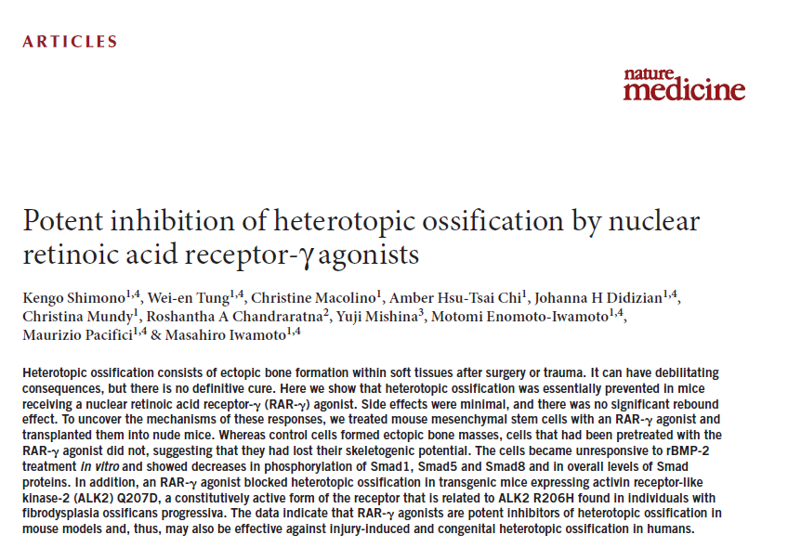
Pre-clinical drug testing program

Slide 51
Why clinical trials fail
Lack of or incorrect natural history studies
Genotypic or phenotypic diversity not represented
Inappropriate outcome measures
Lack of biomarkers

Slide 52
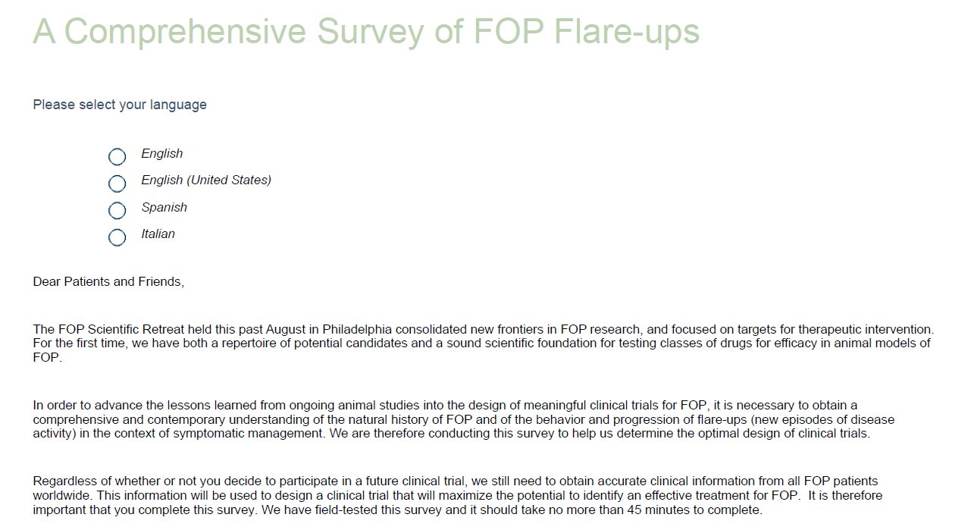
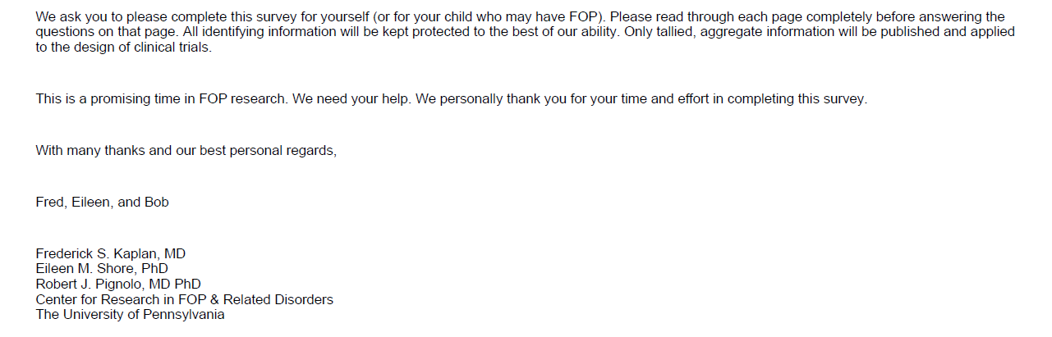

Slide 53
Acknowledgements
This work was supported in part by:
The International FOP Association
The Center for Research in FOP and Related Disorders (University of Pennsylvania)
The Ian Cali Endowment
The Weldon Family Endowment
The Isaac & Rose Nassau Professorship of Orthopaedic Molecular Medicine
The Rita Allen Foundation
The Betty Laue Resource Center
Friends and Families of FOP patients worldwide

Slide 54
Cardiopulmonary Function in FOP
During hospitalizations or in more advanced disease, individuals with FOP may have more trouble clearing secretions, leading to:
Atelectasis
Pneumonia
Respiratory failure requiring intubation
Secretion clearance is enhanced by hydration, guaifenesin, bronchodilators and mucolytics, as needed
Devices to loosen secretions
handheld devices that cause vibration of airway walls during exhalation
garments that vibrate the chest wall
specialty beds that turn and oscillate
patients with a weak cough may unable to expectorate secretions
Mechanical insufflation-exsufflation devices
non-invasively extract secretions
dramatically increase peak cough expiratory flow
Method to loosen secretions + in-exsufflation to remove them

Slide 55
Pressure Ulcers in FOP
Skin breakdown and pressure sores are common
Skin breakdown can occur from increased pressure over normotopic or heterotopic bone
Pressure sores can develop suddenly, progress rapidly, and be difficult to treat (Kantanie, 2008)
Preventive measures include:
Frequent changes in position
Use of a pressure-reducing mattress or bed
Daily skin inspections
Adequate nutrition
Treatment proceeds as in individuals without FOP

Slide 56
Hearing Impairment in FOP
Children with FOP should generally have audiology evaluations every other year; more often, if necessary
Hearing aids are often helpful and can diminish developmental problems due to hearing loss (Levy et al., 1999).

Slide 57
Limb Swelling in FOP
Some patients who have advanced FOP involving the lower limbs have venous stasis and/or lymphedema
Definitive studies to exclude deep vein thrombosis may be difficult to obtain and interpret due to severe existing deformity and joint ankylosis from previous flare-ups
A decision to anticoagulate a patient should not be made without substantial evidence of deep vein thrombosis.
Limb swelling is often difficult to treat effectively in patients who have FOP
Non-steroidal anti-inflammatory medications and glucocorticoids generally have not been effective
Support stockings when tolerated
Elevation of the affected limbs is often impossible because of ankylosis of the major joints
Pneumatic compression devices has not been evaluated
Anecdotal beneficial effects following treatments at lymphedema clinics

Slide 58
Pregnancy Issues in FOP
If a parent has FOP, the chance that the child will have FOP is fifty percent
Specific risks to the mother include, but are not limited to:
Risk of FOP flare-ups during pregnancy
Risk of breathing difficulties during the latter part of pregnancy
Risk of childbirth complications
Caesarian section is necessary due to the pelvic deformity, joint fusions, and decreased plasticity of the birth canal that will not safely accommodate a normal vaginal delivery
Risk of the general anesthesia for Caesarian delivery
Risk of phlebitis and pulmonary embolism

Slide 59
Pregnancy Issues in FOP
Specific risks to the child include, but are not limited to:
Risk that the child may have FOP
Risk of prematurity
Risk of severe fetal distress
Risk of cerebral palsy
Risk of complications from general anesthesia
At delivery, there should be a team skilled in resuscitation of high risk infants

Slide 60
Fractures in FOP
Fractures can occur in both normotopic and heterotopic bone
Fractures of heterotopic bone occur commonly and heal rapidly
Elevation, rest, splinting, and local application of ice are often helpful
May be supplemented by narcotic analgesia, as needed
Fractures of normotopic bone need to be carefully evaluated, as in any patient
Closed reduction and splinting is sufficient for most fractures
Open reduction or internal fixation is almost never warranted and can lead to rapid onset of heterotopic ossification
Healing may be delayed in osteoporotic bone
Nonunion has not been reported in FOP (Einhorn & Kaplan, 1994), but unpublished anecdotal reports suggest that glucocorticoids may delay healing of features in the normotopic skeleton of FOP patients.

Slide 61
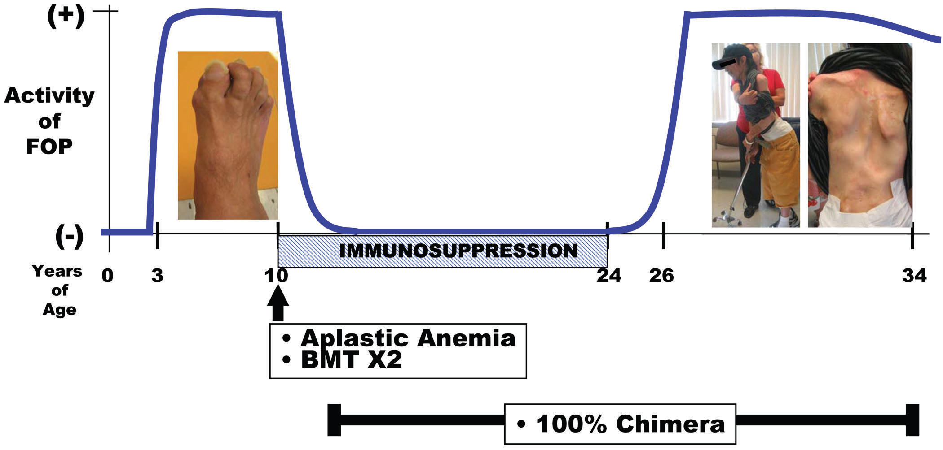
Bone Marrow Transplantation
Kaplan, FS et al. JBJS 89:347-57 (2007)

Slide 62
Bone Marrow Transplantation
Replacement of the FOP patient’s bone marrow with normal donor bone marrow cured his fatal bone marrow condition but was not sufficient to prevent further heterotopic ossification and progression of his FOP
However, acute immunoablation and chronic immunosuppression quenched the activity of his FOP
Even normal bone marrow-derived cells were capable of stimulating heterotopic ossification in a genetically susceptible individual (Kaplan et al., 2007)
General use of potent immunosuppressive medications is not advocated in the routine management of FOP, and would likely be extremely dangerous and possibly life-threatening if it were applied broadly to the FOP community

Slide 63
Rosiglitazone
One report claims that rosiglitazone (Avandia), an anti-inflammatory and anti-diabetic agent that alters the fate of marrow stromal cells, “is associated with major clinical improvements in a patient with fibrodysplasia ossificans progressiva (FOP).” (Gatti et al., 2010)
Gatti et al describe a 48 year-old woman with FOP characterized by continuous flares that she was partially controlling with prednisone
She took rosiglitazone (initially 4 mgs, and then 8 mgs daily) for 14 months. No new flares were observed during rosiglitazone therapy, as compared to five episodes observed during the previous year while on 20-25 mgs of prednisone daily

Slide 64
Rosiglitazone
Rosiglitazone appears to have an adverse effect on the skeleton (McDonough et al., 2008; Meier et al., 2008).
Rosiglitazone has adverse cardiovascular side effects including an increased risk of heart attacks and death from all cardiovascular causes (Nissen et al., 2007).
Rosiglitazone causes osteoporosis and decreased skeletal strength that is reminiscent of aged bone (McDonough et al., 2008).
Pathologic fractures of long bones occur with chronic rosiglitazone use (Meier et al., 2008).
Rosiglitazone is not approved for use in children.
Concerns:
Drug treatment in a single patient, not in multiple patients without controls
Flare-ups of FOP are sporadic and unpredictable, and there is great individual variability in the rate of disease progression

Slide 65
Miscellaneous Agents
Calcium binders
Mineralization inhibitors
Antiangiogenic agents
Fluoroquinolone antibiotics
PPAR-gamma agonists
Colchicine
Warfarin
TNF-alpha inhibitors
Unsatisfactory or equivocal results
Anecdotal reports
Data are scant
No published series
At the present time, the use of these medications or approaches can not be endorsed

